Slide 1


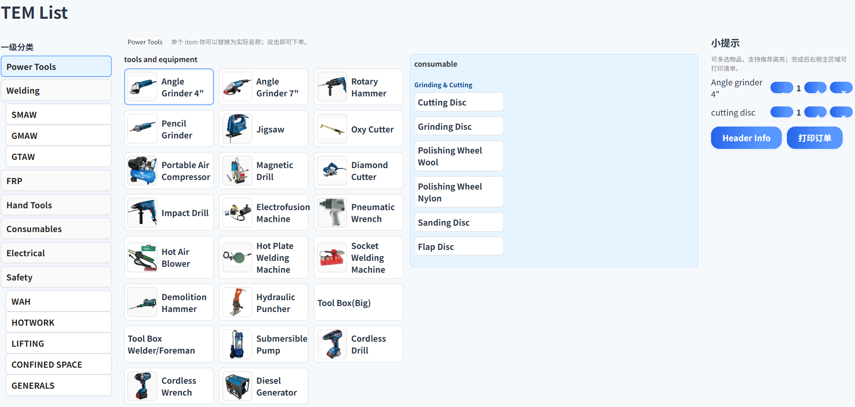
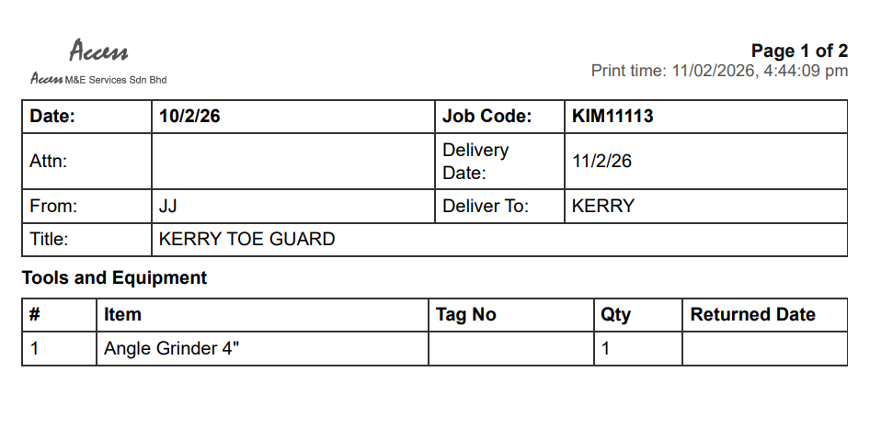
https://accessmne.github.io/tem-list.html
TEM List – User Manual
Right panel: Cart
Change quantity by clicking -/+
Remove item by ‘x’
Recommend item (if any)
QR CODE FOR WEBSITE
Fill in job info (optional)
Print TEM list
Print preview:
Separated for Tools / Consumables
Left panel: Category
Click a category (or sub-category under Welding/Safety) to change the item list
Middle panel: Item
double‑click an item card to add to cart

